Slide 1

Balneotherapy and skin.
Mechanisms of action.
Carbajo JM¹⁻², Maraver F¹⁻³
Dept. of Physical Medicine and Rehabilitation. Medical Hydrology, Faculty of Medicine, Universidad Complutense Madrid, Madrid, Spain
Laboratorios SkinWine. Avda. Puerta del Sur S/N, Jerez de la Frontera (Spain)
Professional School of Medical Hydrology and Hydrotherapy. Faculty of Medicine. Universidad Complutense de Madrid, Spain.
Notes:
Good evening. It is a pleasure for me, to present in this event that we commemorate the 190th anniversary of health resort Haapsalu, Estonia, the work about …

Slide 2
Balneotherapy skin products
are ones that have been scientifically designed, based on inorganic salts in order to improve the viability of skin cells
Osmotic activity
Crenotherapy activity
Notes:
For us, Balneotherapy Dermatological products ...
We can distinguish two different effects:
- The ones caused by the osmotic properties of the same
- The properties caused by the quality of its waters, that is, the presence of special mineral salts.

Slide 3
Skin Water absorption
Tritium-labelled water is absorbed through the skin. Pinson (1942, 1952)
At 10 to 15 minutes into the bath, is detected in blood and urine. (Amelung & Hildebrant, 1985)
  Skin Absorption: (San Martín & Arango, 1989)
  2-4 μL/cm²/h of water
  1.2-1.5 times the weight of the SC
Notes:
We can say that water, even minimally, is absorbed through the skin.
10 or 15 minutes after starting a bath, we detected the presence of labelled water with radioactive isotopes in blood and urine.
Moreover, we have quantified the skin absorption of water between 2-4 μL/cm2/h. That is between 1.2-1.5 the weight of the stratum corneum.
PINSON, EA (1942, 1952) citado por AMELUNG y HILDEBRANDT, op. cit. pg. 222
AMELUNG, W.; HILDEBRANDT, G. (1985): " Balneologie und medizinische Klimatologie" Band 2. Springer-Verlag Berlin Heidelberg.
SAN MARTÍN BACAICOA, J.; SAN JOSÉ ARANGO, C. (1989): "Paso a través de la piel de los factores mineralizantes de las aguas utilizadas en balneación". Bol. Soc. Esp. Hid. Méd. Vol.IV. nº 1, 27-32.

Slide 4
Skin absorption
After a bath of one hour, the body absorbs:
  at least 20 mL water (San Martín & Arango, 1989)
  Very well: gases dissolved in water
  Worst: salts dissolved in water
Higher concentration ➔ increased absorption (Pratzel y Schnitzer, 1992)
  Skin is not a semipermeable membrane
  Stratum corneum has a solute concentration equivalent to 60 g/L
Notes:
After bath, are absorbed by the skin, at least 20 mL of water, most of gases dissolved in the water and the salts poorly dissolved in the water.
And the salts, up to a limit, the higher concentration, the higher absorption capacity.
This is because the skin doesn’t behave as a semipermeable membrane, and the stratum corneum has a solute concentration equivalent to 60 g/L. So the water below this concentration, would be unable to be absorbed. Consequently, passive diffusion is not the only absorption mechanism.
SAN MARTÍN BACAICOA, J.; SAN JOSÉ ARANGO, C. (1989): "Paso a través de la piel de los factores mineralizantes de las aguas utilizadas en balneación". Bol. Soc. Esp. Hid. Méd. Vol.IV. nº 1, 27-32.
PRATZEL, H.; SCHNIZER, W. (1992): "Handbuch der Medizinischen Bäder". Ed. Haug. Heidelberg.

Slide 5
Post reabsorption
Subsequent reabsorption of deposits that have been stored in the skin
  Cl⁻ and Na⁺ are detected up to 100 hours after bath
  SC has external water storage capacity
Notes:
Another phenomenon to be considered is reabsorption of salts retained in the stratum corneum.
Traces of Cl- and Na + were detected in epidermis up to 100 hours after bathing.
This shows us, that the rate of resorption for that element, should be considered as a vital consideration in absorption from the salts through the skin.
SAN MARTÍN BACAICOA, J.; SAN JOSÉ ARANGO, C. (1989): "Paso a través de la piel de los factores mineralizantes de las aguas utilizadas en balneación". Bol. Soc. Esp. Hid. Méd. Vol.IV. nº 1, 27-32.

Slide 6
Bath absorption
Salt | Minimum concentration limits (mg/kg) | Resorption rate (nL/cm²) | Bath absorption (without skin) μg
Sodium (Na⁺) | 600 | 169 | 2.000
Potassium (K⁺) | 700 | 44 | 600
Calcium (Ca²⁺) | 300 | 18 | 100
Magnesium (Mg²⁺) | 20 | 200 | 80
Iron (Fe^{2+, 3+}) | 20 | 2 | 0.8
Chloride (Cl⁻) | 1.000 | 22 | 40
Fluoride (F⁻) | 50 | 20 | 20
Iodine (I⁻) | 10 | 40 | 8
Sulphates (SO₄²⁻) | 1.000 | 4 | 80
Pratzel (1987) and San Martín & San José (1989)
Notes:
Pratzel in 1987, suggested a new classification of the mineral water used in balneotherapy, based on the minimum limit concentrations to ensure penetration through the skin. Some of these values are reflected in this table from San Martin and San José, 1989.
From these values it follows that large ions, such as sulphate, hardly penetrate the epidermis and therefore can not be expected therapeutic skin effects.
You can also see that if the skin is removed, the absorption capacity, depends mainly on their molecular weight.
SAN MARTÍN BACAICOA, J.; SAN JOSÉ ARANGO, C. (1989): "Paso a través de la piel de los factores mineralizantes de las aguas utilizadas en balneación". Bol. Soc. Esp. Hid. Méd. Vol.IV. nº 1, 27-32.

Slide 7

Absorption pathways
Routes of entry
  Trans-epidermal
  Trans-appendicular
Entry capacity
  Adsorption
  Penetration
  Absorption
Skin conditions
  Injured skin
  Stratum corneum
    Fixation
    Thickness
    Skin area
  Biotransformation
Diffusion pathway | Quantity per cm² | Absorption rate (%) | Diffusion constant cm²/seg
Hair follicle | 40-70 μL | 0.04-0.1 | 5-10 x 10⁻⁸
Sweat gland | 299-250 μL | 0.15-1.2 | 1-20 x 10⁻⁶
Transcellular |  | 99.0-99.9 | 1-10 x 10⁻¹¹ (Dry skin)
Taken from Scheuplein (1971) & García –Delgado (2004) |  |  | 5-10 x 10⁻⁶ (Wet skin)
Notes:
Another issue is the way of absorption. It’s general opinion, that the most effective way of penetration is the transepidermal route, because, even with low values in the diffusion constants, the application area is much higher and performance is finally better.
The different substances can adhere to epidermis surface,  can penetrate and even  overcome the epidermis, reaching the dermis and to be absorbed. Anatomically, it mainly depends on the condition of the skin. Binding capacity of the various substances to the stratum corneum. State of corneal thickness and the size of the treated skin surface. Besides, transformation of the different substances in the skin.
García-Delgado R, Escario-Travesedo E, Sánchez-Romero A. Uso racional de la medicación tópica en dermatología. Med Cutan Iber Lat Am 2004; 32(1): 39-44

Slide 8
External conditions
Concentration
Temperature
pH
Contact time
Skin absorption seems very unlikely to be able to have effects systemically.
Pratzel y Schnitzer (1987-89)
Notes:
External conditions are also important. Concentration of the substances, temperature of the water, pH and its influence on salt ionization and time of contact between the substance and skin, have a remarkable importance in the ability of skin absorption.
In the words of Pratzel and Schnitzer (1987-1989), in any case ...

Slide 9
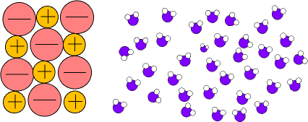
Salts and solvation
Notes:
But we have not considered an important cellular phenomenon of osmosis.
As it is known, the salts have the phenomenon of solvation, and they are able to originate the osmosis process. Salts have the capacity to hold water.

Slide 10
Osmosis (water force)
NaCl 1M NaCl 0,1M
Piston
H₂O
Semipermeable
Membrane
Notes:
This means, that in a semipermeable membrane which separates two solutions with different concentrations of solutes, for example, 0.1 M NaCl on one side, and 1 M NaCl in the other, the water will tend to move from the more dilute to the more concentrated, and the water flow will continue until NaCl concentrations equal in both solutions.  This phenomenon is also called water force.

Slide 11
Isotonic medium Hypotonic medium Hypertonic medium
C_{i}= C_{e}➔ π = 0 J_{v}= 0
C_{i} > C_{e}➔ π > 0 J_{v}< 0
C_{i} < C_{e}➔ π < 0 J_{v} > 0
H₂O
H₂O
^{Swelling}
^{Shrinkage}
Notes:
The flow of water across cell membranes, depend on the ratio of the salt concentration between, the external cell environment, and intracellular salt concentration.
 Because of that, the cells suffer from swelling and shrinkage.

Slide 12
Solute gain
Solute loss
Normal
Volume
RVI
Regulatory Volume Increase
RVD
Regulatory Volume Decrease
Notes:
To balance these phenomena, animal cells regulate their cell volume with the loss or gain of solutes. At first phenomenon we call  RVD and  the second RVI.

Slide 13
Solute Gain
Solute Loss
H HCO₃
RVI
RVD
Normal Volume
K
Cl
Na
Cl
K
Cl
Na
K
2Cl
RVI
Regulatory Volume Increase
RVD
Regulatory Volume Decrease
Notes:
To defend themselves the cells lose Potassium Chloride through two channels and one co-transporter.
 And the opposite, when the cells are shrunk, they gain salts (Potassium and Sodium Chloride) and lose bicarbonate to maintain the pH of the cells.

Slide 14
Cell volume regulation
Determines the form and intracellular osmolality
Responsible for a multitude of cellular functions:
Osmolites: Regulatory molecules
    Growth
    Migration
    Differentiation
    Cell death
    Intracellular metabolism
    Epithelial transport
    Cell excitability
    Releasing hormones
Wehner F, Olsen H, Tinel H, Kinne-Saffran E, Kinne RK. Cell volume regulation: osmolytes, osmolyte transport, and signal transduction. Rev. Physiol Biochem Pharmacol, 2003;148:1-80
Lang F, Busch GL, Ritter M, Volkl H, Waldegger S, Gulbins E, Haussinger D. Functional significance of cell volume regulatory mechanisms. Physiol Rev, 1998;78: 247-306
Notes:
The cell volume regulation not only determines the form and osmolality, it’s responsible for multiple essential functions for the life of our cells as ...... where molecules called osmolytes are also jointly responsible of this operation.

Slide 15

Hypotonic medium
Water
Salts
Notes:
In the case of a hypotonic medium,  the water tends to enter the cell, which has a higher salt concentration and consequently the cell swells.

Slide 16
Water
Salts
Osmolites
Notes:
To try to alleviate this phenomenon,  cells possess molecules called osmolytes that supplant the lack of extracellular salts.

Slide 17

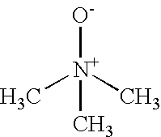
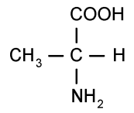

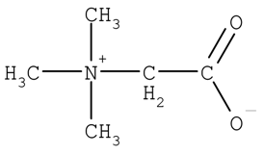
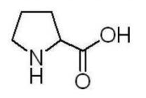
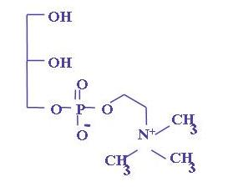

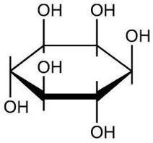
Aminoacids Polyols Methylamines
Glycerin
TMAO
Alanine
Proline
Betaine
Sorbitol
Taurine
myo-inositol
Gliceryl-fosfatidylcoline
Notes:
These molecules belong to three classes of families: amino acids, polyols and methylamines. These molecules are very common and the best known are ....

Slide 18
Na
Glucose
myo-inositol
Aldose
reductase
NaCl
Sorbitol
Betain
Osmolites
Notes:
Osmolytes may be synthesized inside the cells or  be found in the extracellular medium and can be introduced into the intracellular medium, such as going into the extracellular medium.

Slide 19
SW
RVD
Cellular Volume
N
Time
Hypotonic
Necrosis
NVI: Necrotic Volume Increase
SH
(N: normal; SW: swelling; SH: shrinkage)
Notes:
When the cells are in an Hypotonic medium, they have a swelling, that are recovered through two mechanism, one is salty, very quick, and the other one slower, due to organic molecules named osmolites.
 The failure of this mechanism leads the cell to a necrosis process, if the cell membrane is thin.

Slide 20
Hypertonic medium
Water
Salts
Notes:
When the concentration of intercellular salts is high,  water is extracted from the Interior of the cell, and the cell shrinks.

Slide 21
Water
Salts
Osmolites
Notes:
This phenomenon is minimized by osmolytes that are capable of emulating the function of the salts.

Slide 22
Apoptosis
AVD: Apoptotic Volume Decrease
SW
Hypertonic
Cellular Volume
N
Time
RVI
SH
(N: normal; SW: swelling; SH: shrinkage)
Notes:
In hypertonic media the process is similar, but now its failure leads to apoptosis.

Slide 23
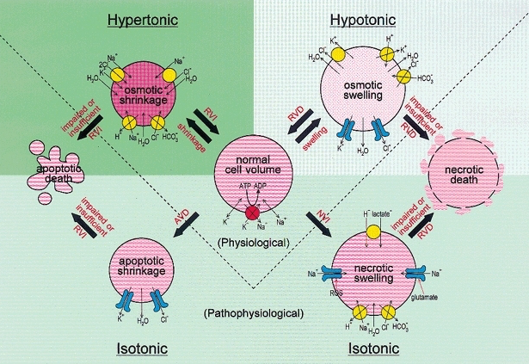
Notes:
Then, we have two situations, one physiological and other pathological, above and below the dotted line. In pathological cases, and especially, when the cell membranes are very thin or impaired, they are destroyed by necrosis or apoptosis.

Slide 24
Crenotherapy activity
Sodium Chloride waters
Magnesium waters
Bicarbonates waters
Trace elements waters
Sulphurous waters
Matz H, Orion E, Wolf R. Balneotherapy in dermatology. Dermatol Ther. 2003; 16(2): 132-40.
Notes:
As first conclusion, we can say that all the salts present in the water, act as a single elemental, depending on its salt concentration. Although, as you know, in addition, some of them, have some different characteristics due to the particular qualities of its ions. We say then, that the mineral waters, work by their crenotherapy activity. Where waters containing sodium chloride are especially active in irritative skins, magnesium-rich waters are prescribed for sensitive skins, bicarbonate waters are indicated in sweat gland problems and the different waters depending on the different elements they contain.  As you know, we have a complete review in this classic article. Especially active are the sulphur waters, which will be discussed in depth

Slide 25
Sulphurous waters
Keratoplastic: reduced form and / or low concentration of sulphur
Keratolytic: oxidized form and / or high concentration of sulphur
Renewing: stimulates cell proliferation in stratum spinosum
Vascular effects: oedema and pruritus
Antifungal and antibacterial properties
Notes:
Those are the main properties of the sulphurous water behaviour on the skin.

Slide 26
Special Crenotherapy activity
Types of sulphur in mineral waters
Valence Form
-2 Sulphides (H₂S)
0 Elem. sulphur (S)
+2 Hyposulphites(H₂S₂O₃)
+4 Sulphites (H₂SO₃)
+6 Sulphates (H₂SO₄)
Oxidation
Reduction
Notes:
But the sulphur doesn't act into the skin in an unique way. It depends on the molecular status.  It depends on the degree of reduction or oxidation which is usually motivated by the external environment.

Slide 27

Natural Sulphur Cycle
Oxidation within atm. Sulphur Cycle
?
?
?
H₂S
RSH
RSR
Chromatiaceae
Chlorobiaacea
Decomposition
Org. -SH Compounds
Chromatiaceae
Chlorobiaacea
+
H₂
O₂
S₀
+
Beggiatoa
Thiothrix
Assimilatory
Sulphate Reduction
Dessimilatory
Sulphate Reduction
Thiobacillus
Thiomicrospira Thermothrix
SO₄²⁻
2 CO₂ + H₂S + 2 OH⁻ + hv ➔ 2 < CH₂O> + SO₄²⁻
Anaerobic Phototropic
2 H₂S + O₂ ➔ 2 H₂O + 2 S
Aerobic
S + H₂O + 1½ O₂ ➔ SO₄²⁻ + 2 H⁺
Aerobic
Anaerobic
8 [H⁺] + SO₄²⁻ ➔ H₂S + 2 H₂O + 2 OH⁻
Notes:
In nature, hydrogen sulphide is generated by decomposition of organic matter, and is aerobically or anaerobically oxidized to elemental sulphur and then to sulphates, by bacteria and other microorganisms, through the following reactions.  Also in nature there are other processing parallel to the sulphur cycle.
Likewise, sulphates can be reduced hydrogen sulphide, by assimilation of living beings or decomposition by microorganisms, so that the sulphur cycle would close.
Barton LL, Fardeau ML, Fauque GD. Hydrogen sulfide: a toxic gas produced by Dessimilatory sulfate and sulfur reduction and consumed by microbial oxidation. Met Ions Life Sci. 2014; 14: 237-77

Slide 28
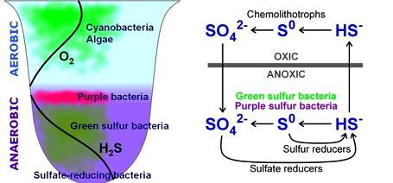
Aerobic vs. Anaerobic
Notes:
Thus, with the aim of simplifying, anaerobic reduction of sulphates originates hydrogen sulphide which is aerobically oxidized to sulphate.

Slide 29
H₂S Properties
Gas very soluble in water: ≈ 80 mM (37ºC)
pH
H₂S HS⁻ S²⁻
pKa 7.04
pKa 11.96
Physiological pH (7.4): H₂S / HS⁻ is ≈ 1:3
Temperature
At 37ºC ➔ 20% H₂S 25ºC ➔ 40% H₂S
Oxygen concentration
Notes:
Chemically, hydrogen sulphide is a gas and as a weak acid it’s highly soluble in water. Its toxic effects are comparable to carbon dioxide and cyanide. Sulphur forms change at two critical pH 7.04 and 11.96  At physiological pH concentration ratio of H2S is 1:3 concerning to HS-  Moreover, two identical solutions of hydrogen sulphide have different concentration at different temperature and finally,  the presence of oxygen facilitates oxidation of hydrogen sulphide to sulphate.

Slide 30
Skin pH
Physiological pH
Gas
H₂S
HS⁻
S²⁻
Salt
Salt
7.04
9.5
11.96
Notes:
Let us reflect further on these concepts…….  Hydrogen sulphide is the only form of sulphur at acidic pH. At 7.04 it’sthe 50% of the concentration and when the pH is about 9.5 only SH- exists. From 9.5 S2- starts forming. If we look at physiological pH, only a third of the sulphur is found as hydrogen sulphide, although skin pH,  virtually, all sulphur is found as hydrogen sulphide.
We also have to make another assessment. Hydrogen sulphide is a gas while the other forms are salts, so the potential for absorption of hydrogen sulphide is much greater than their soluble salts.

Slide 31
Properties
pH: 7.4
pH: 11.0
pH: 9.5
  In vivo coexist both: gas and anions
  Reactivity of dissociated HS⁻􏰀 is higher than H₂S
  At pH ≈ 9.5 mainly exists as HS􏰀⁻
  Oxygen influences the production and availability of sulphides
Notes:
In the graph we represent reduction force as a function of pH, this leads us to the following reflections:  1. In vivo both coexist: gas and anions  2. Reactivity of dissociated HS⁻􏰀 is higher than H₂S and has a maximum at eleven pH. 3. The presence of oxygen may decrease the reduction force, so the sulphur salts are more active into the skin than on the surface of the skin.

Slide 32
Crenotherapy activity on skin
(Sulphurous waters)
H₂S ➔ HS⁻ + H⁺
HS⁻ ➔ S²⁻ + 2 H⁺
S²⁻ ➔ S + H₂
Keratolytic/keratoplastic properties
  Reductive/oxidative capacity
Antifungal activity
  Conversion in Pentatonic Acid (H₂S₅O₆)
Notes:
Part of the activity of cutaneous sulphurous waters is based on the formation of colloidal sulphur inside the skin, by chemical reactions or microbial metabolism.
And then it acts as a keratolytic-keratoplastic by its reducing-oxidizing ability or sulphur becomes pentatonic acid, with antifungal properties.

Slide 33

Wani R, Nagata A and Murray BW. Protein redox chemistry: post-translational cysteine modifications that regulate signal transduction and drug pharmacology. Front. Pharmacol. 2014; 5: 224. doi: 10.3389/fphar.2014.00224
Oxidation
CORNEOCYTE
CORNEOCYTE
S ⬅ SH₂
- CO - CH- NH -
Ι
CH₂
Ι
SH
SH
Ι
CH₂
Ι
- CO - CH- NH -
- CO - CH- NH -
Ι
CH₂
Ι
S
Ι
S
Ι
CH₂
Ι
- CO - CH- NH -

H₂S₅O₆⬅ O⁻₂•+ S
Cystine + 2H⁺ + 2e⁻ ➔ Cysteine
Reduction
CORNEOCYTE
CORNEOCYTE
S ➔ SH₂
Lin AN, Reimer RJ, Carter DM. Sulfur revisited. J Am Acad Dermatol 1988; 18(3): 553-8
Notes:
So, Sulphur can destroy the disulphide cystinic bonds between corneocytes forming two cysteine ​​molecules, promoting desquamation of the stratum corneum favouring a keratolytic activity or  in the deeper layers of the epidermis Sulfur may also interact with the oxygen radicals to be transformed in pentatonic acid
 2. in particular conditions, hydrogen sulfide can react with cysteine restoring the disulfide links and favouring keratoplastic activity
MCMurtry CW. Dermatologic therapeutics: sulphur. J Cutan Dis 1913;322:399-408.
Jones DP, Go YM, Anderson CL, Ziegler TR, Kinkade JM Jr, Kirlin WG. Cysteine/cystine couple is a newly recognized node in the circuitry for biologic redox signalling and control. FASEB J. 2004; 18(11): 1246-8

Slide 34


Keratolytic effect







Notes:
Therefore, we can say that the sulphurous waters have keratolytic or keratoplastic properties according to different circumstances.

Slide 35
Hydrogen Sulphide
Colloidal Sulphur
Hydrogen Sulphide
Colloidal sulphur
  Adsorption
Hydrogen Sulphide
  Penetration
  Absorption
Epidermis
Dermis
Notes:
As it is known, the pH of sulphur waters is crucial and it is responsible for the therapeutic effect. Superficial or deep effects depending of the formation of sulphur on the surface or in the depth of the skin.  While colloidal sulphur acts on the skin surface, the hydrogen sulphide is able to penetrate or be absorbed through the skin.

Slide 36
Cellular absorption
H₂S
HS⁻ + H⁺
pH 7.4
AE1
pH 7.0
Cl⁻
Mammalian (37ºC)
H₂S
HS⁻ + H⁺
intracellular
H₂S
HS⁻ + H⁺
pH 6.0
HS⁻ channel
pH 7.4
Bacteria
(RT ≈ 25ºC)
H₂S
HS⁻ + H⁺
intracellular
Kimura H. Hydrogen sulfide and polysulfides as signalling molecules. Proc Jpn Acad Ser B Phys Biol Sci. 2015; 91(4): 131-59.
Notes:
 In mammalian cells, H2S passes through the membrane and its salts through HS- channels are exchange for Cl- (anion exchange protein AE1 transports) .  In extracellular matrix, under physiological conditions, at pH 7.4 and 37 °C, only approximately 20% H2S exists as a gas. H2S dissociates to HS- with a trace amount of S2- . This means that the main absorption occurs as HS-.  H2S is released from the cell and then dissociates under extracellular environment where pH is slightly higher than inside the cell.  The reaction has the following principal direction. In bacteria the extracellular environment pH is slightly lower than inside the cell,  while H2S enters into cells through the plasma membrane,  HS- is released through HS- channels to the extracellular environment.  The reaction now has the opposite direction. But ……

Slide 37
H₂S
HS⁻ + H⁺
pH 7.4
AE1
pH 7.0
Cl⁻
Mammalian (37ºC)
H₂S
HS⁻ + H⁺
intracellular
H₂S
HS⁻ + H⁺
pH 4.5 - 6
AE1
pH 7.4
Cl⁻
Skin
(RT ≈ 35ºC)
H₂S
HS⁻ + H⁺
intracellular
Notes:
 In the skin, extracellular environment pH is strongly higher than inside the cell. Thus, hydrogen sulphide is the main molecule in the absorption and release of sulfur.  Logically the circuit direction is different.

Slide 38
H₂S as gasotransmitters
⬆ VEGF
Vascular Endothelial Growth Factor
CSE
cystathionine gamma-lyase
L-cysteine
H₂S
Endothelial Cells (EC)
SKIN
H₂S
Altaany Z et all. Schematic representation of proposed pathways of H₂S-induced NO production and angiogenesis. Cell. Mol. Med. 2013; 17(7): 879-888
Notes:
Recently, hydrogen sulfide are known as gasotransmitters. This gaseous messenger (H2S)  can be generated from L-cysteine by the enzymatic action of CSE.  Hydrogen sulphide-induced relaxation of vascular tissue, but it was partially reduced by the removal of the vascular endothelium or in the presence of L- NAME (an inhibitor of Nitric Oxide synthase). As a consequence of these mechanisms, there are a new microvessels formation (angiogenesis).  Contribution through the skin of hydrogen sulphide can replace this effect. The pro-angiogenic effects of H2S are associated with an increase  in vascular endothelial growth factor expression, and activation of its receptor.
Akt: gen de la PK-b NOS: NO synthetase ERK: extracellular-signal-regulated kinases (ERKs) or classical MAP kinases

Slide 39
Non-Enzymatic production of sulphide
Glucose metbolism, Glutathione, Elemental sulfur or Polysulfides
Yu Zhao, Tyler D. Biggs and Ming Xian. Hydrogen sulfide (H2S) releasing agents: chemistry and biological applications. Chem. Commun., 2014, 50, 11788-805
Notes:
We know three non-enzymatic produce hydrogen sulfide ways:  through sulphur proteins, sulfite and thiosulfate. And conversely,  there are five ways removing hydrogen sulfide in our organism: by conversion in thiocyanate, sulfur proteins, thiosulfate, converting hemoglobin in sulfohemoglobin, and finally methane-thiol transformation.

Slide 40
Enzymatic production of sulphide
CBS: Cystathionine b- synthase
CSE: Cystathionine c-lyase
Kimura H. Hydrogen sulphide and polysulfide's as Biological Mediators. Molecules. 2014; 19: 16146-57
MST:
3-mercaptopyruvate sulphur-transferase
Notes:
Enzymatic synthesis of H₂S involves three enzymes in the mammalian systems, Cystathionine b-synthase (CBS), Cystathionine c-lyase (CGL or CSE) and 3-mercaptopyruvate sulfurtransferase (MST).

Slide 41
Microbial transformation
Pseudomonas spp.
  SH₂ ➔ S₀
  S₂O₆²⁻ ➔ S₄O₆²⁻
Acinetobacter spp.
  S₀➔S₂O₆²⁻
Alcaligenes spp. & Ochrobactrum spp.
  S₂O₆²⁻ ➔ S₄O₆²⁻
Pacheco Aguilar JR, Maldonado Vega M, Peña Cabriales JJ. Metabolismo del azufre de aislados bacterianos provenientes de un humedal artificial empleado para el tratamiento de efluentes de la industria curtidora. Rev. Int. Contam. Ambie. 2012; 28(3): 195-201
Notes:
And also some human bacteria are able to transform the sulphur derivatives.

Slide 42
Storage and release of H₂S
Gopi K. Kolluru, Xinggui Shen, Shyamal C. Bir, Christopher G. Kevil: Hydrogen sulphide chemical biology: Pathophysiological roles ^{and detection.} ^{Nitric Oxide. 2013; 35: 5–20}
Notes:
As a summary, the factors implicated in the storage and release of H2S are  pH,  oxidation and reduction,  hydrogenation and alkalization,  microorganisms like sulphate reducing bacteria (SRB), apart from  enzymatic catalyses through different enzymes ( CSE, CBS, 3MST, sulphite reductase a-sub unit (CysJ), anaerobic sulfide reductase A (AsrA))

Slide 43
H₂S in Keratinocytes
Hydrogen Sulfide
^{Proliferation}
^{increased}
^{Cytostatic effect}
VEGF
NOS
Nucleus
iNOS
Low
concentration
High
concentration
pAkt
pERK
Akt
Nitric Oxide
Nitric Oxide
ERK
Keratinocyte Cytoplasm
Merighi S, Gessi S, Varani K, Fazzi D, Borea PA. Hydrogen sulfide modulates the release of nitric oxide and VEGF in human keratinocytes. Pharmacol Res. 2012; 66(5): 428-36
Notes:
As described, hydrogen sulfide significantly increase nitric oxide production, in a manner Akt-dependent.  Nitric oxide its synthesized from arginine in low concentrations by the COSTITUTIVE NITRIC OXIDE SYNTHASES (NOSs) causing an increase in cell proliferation.  But In higher concentrations, nitric oxide its form by INDUCIBLE NITRIC OXIDE SYNTHASES (iNOS) causing a cytostatic effect and vasodilation.  Increase in nitric oxide is able to down-regulate Extracellular-signal-Regulated Kinases, activation thereby resulting decrease of VEGF release.
Akt: gen de la PK-b ERK: extracellular-signal-regulated kinases (ERKs) or classical MAP kinases

Slide 44
Skin behaviour of H₂S
Low concentration:
  Keratinocytes proliferation
  Vasodilation
  Pro-angiogenesis
High concentration:
  Keratinocytes differentiation (Cytostatic)
  Less vasodilation
  “Anti”-angiogenesis
Notes:
According to these authors hydrogen sulphide has dual behaviour depending on its concentration into the cell.

Slide 45
Skin Immunological effects
On Keratinocytes:
Gobbi et all (2009)
  ⬇ Clonal growth
  ⬇ Cell proliferation
  ⬇ Cell adhesion
Mirandola (2011)
  ⬇ IL-8 expression
On Epidermis:
Mustak et all (2005)
  ⬆ LC migrations
On Neutrophils (PMN) HS⁻ solutions:
Rinaldi et all (2006)
  Prevents apoptosis
  Prevents bacterial activity of PMN
  ⬆ Survival of granulocytes, but not lymphocytes or eosinophils
Notes:
In theses conditions, hydrogen sulfide impairs keratinocyte cell growth and adhesion, inhibiting mitogen-activated protein kinase signalling.
Decrease IL-8 expression via MAP kinase signalling
Stimulates LC migration
HS- promotes the short-term survival of neutrophils, potentially accelerating the resolution of inflammatory processes, and preventing the occurrence of new ones.
HS- prevents apoptosis of human PMN via inhibition of p38 and caspase 3. Neutrophils bactericidal activity is not impaired. Promote survival of granulocytes, but not of lymphocytes or eosinophils due to inhibition of caspase-3 cleavage and p38 MAP kinase phosphorylation

Slide 46
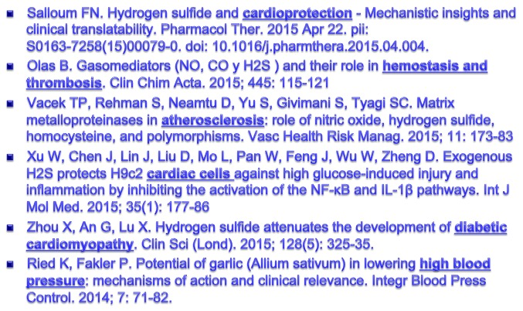
Cardiovascular

Slide 47
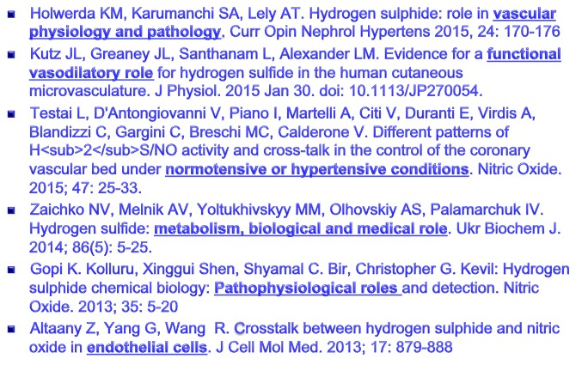
Angiogenesis & blood flow

Slide 48
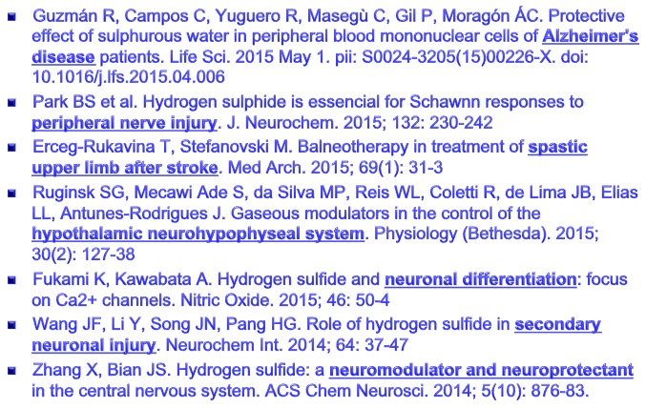
Nerve and brain

Slide 49
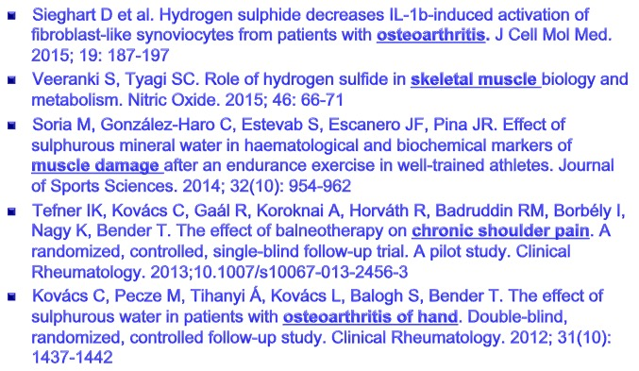
Musculoskeletal pain-inflammation

Slide 50
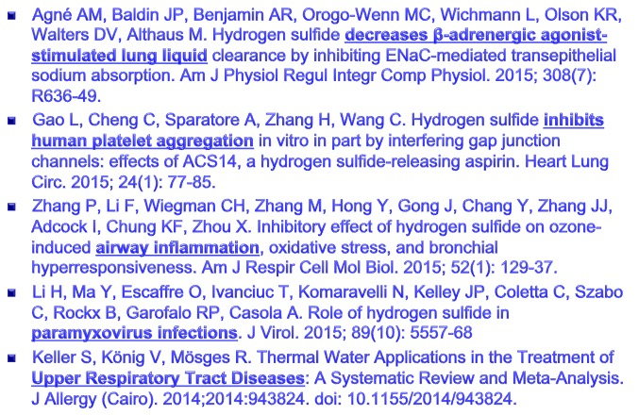
Upper Respiratory Tract Diseases

Slide 51
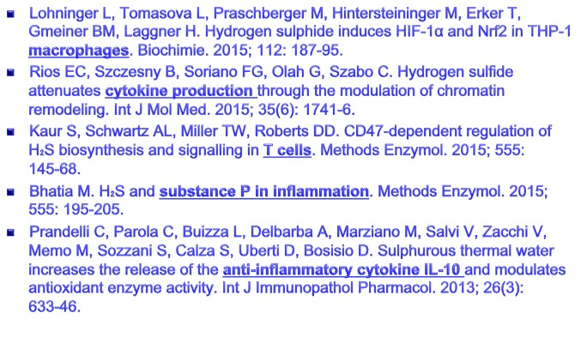
Immunological system

Slide 52
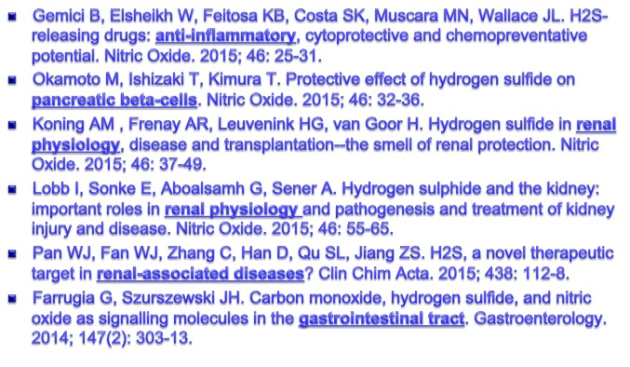
Metabolism & Renal Physiology

Slide 53
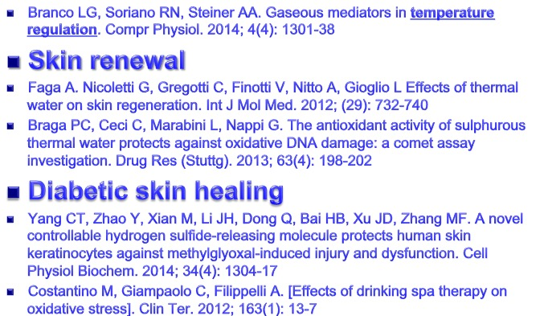
Skin

Slide 54
Health hazards of H₂S
1-10 ppm: smell of rotten eggs
15 ppm: detectable because of the foul smell
50-100 ppm: coughing, slight irritation to the eyes and loss of smell
150-250 ppm: loss of the sense of smell, throat and eye irritation
250-350 ppm: irritation of the eye and respiratory tract
350-450 ppm: difficulty in breathing ,dizziness, serious respiratory disturbance
500- 900 ppm: respiratory disturbances irritation to the eyes and unconsciousness
< 1.000 ppm: unconsciousness, slow pulse, respiratory paralysis and DEATH
Notes:
Hydrogen sulphide has the inconvenience of possible poisoning if proper regulations are not taken.

Slide 55
Some inconveniences:
Eye
  Acute: >25 ppm
  Chronic: serious eye effects
Lungs
  Acute: > 50-100 ppm
  Chronic: <10-20 ppm
Skin
  Normal Spa dosses: anti-irritant
- Lambert TW et al. Hydrogen sulfide and sour gas effects on the eye. A historical perspective. Sci Total Environ. 2006; 367; 1-22
- Ferreira MO, Costa PC, Bahia MF. Effect of Sao Pedro do Sul thermal water on skin irritation. Int J Cosmet Sci. 2010; 32: 205-10
- Lewis RJ, Copley GB. Chronic low-level hydrogen sulfide exposure and potential effects on human health: a review of the epidemiological evidence. Crit Rev Toxicol. 2015; 45(2): 93-123.
Notes:
In spas, these adverse effects are mainly restricted to eyes, lungs and skin.

Slide 56
Sulphurous Spring Dermatitis
Clinical findings of sulphurous spring dermatitis are similar to those of a superficial second-degree burn.
- Lee CC, Wu YH. Sulfur spring dermatitis. Cutis. 2014; 94: 223-5
Notes:
In particular, a study of Taiwan, in which a healthy 65-year-old man presented with painful skin lesions on the legs that developed after bathing for 25 minutes in a hot sulphur spring 1 day prior. The patient had no history of dermatologic disease. He reported a 10-year history of bathing in a hot sulphur spring for 20 minutes every 3 days in the winter. One hour after bathing, he noted confluent, punched-out, round ulcers with peripheral erythema on the thighs and shins .
A skin biopsy revealed acutely demarcated, homogeneous coagulation necrosis of the epidermis. Many neutrophils were present under the necrosis.

Slide 57
Application of solid water?
Mineral water on a solid support
Matured over time
Apply locally or not
Cold or heated
can improve dermatological properties!
Notes:
Can we have a application of solid water? Yes, this is the peloid art!

Slide 58
Solids:
Mineral Fraction
- Precipitates
- Clays
- Sediments
- Peats
Organic Fraction
- Plant residues
- Humus
Water:
Mineral water
Sea water
Lake water
Biologic:
Algae
Bacteria
Zooplankton
Notes:
We manufacture a product with three components: a solid support, mineral waters and favour microbial content to improve its cosmetic and therapeutic properties.

Slide 59
Humus
Humus is similar to the decomposed lignin complex:
  Polymer aromatic rings: fulvic and humic acid
  Carbohydrates and amino acids
Notes:
By fermentation, these components originate a similar lignin decomposed substance consisting of: ......
Humus usually improve the cosmetic properties of peloid.

Slide 60
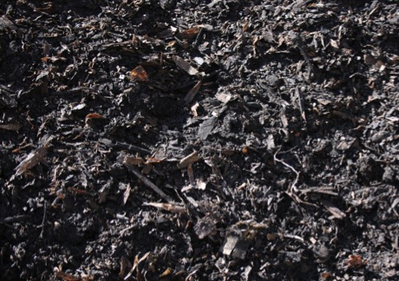
Humification process
Polymerization
Specific Bacterial Action
Aromatic Nucleus
Enzymatic
Oxidation
Humic precursors
atmospheric nitrogen
Fixation
Aliphatic Chains
Polyphenolic Acids
Amino Acids
Bacterial Biomass
Carbohydrates
Melaninas
Alcoholic Acids
Notes:
Humification process is the transformation of polyphenols, amino acids and carbohydrates from soil  through the bacterial biomass, which at the same time is capable of fixing atmospheric nitrogen in  benzenic aromatic molecules (antioxidants and skin absorption promoters),  aliphatic chains (paraffin's and hydrocarbons, a major constituent of the oily phase of cosmetics)  alcoholics acids (waxes of cosmetics) and  melanin, all of them, able to significantly change its organoleptic properties.

Slide 61
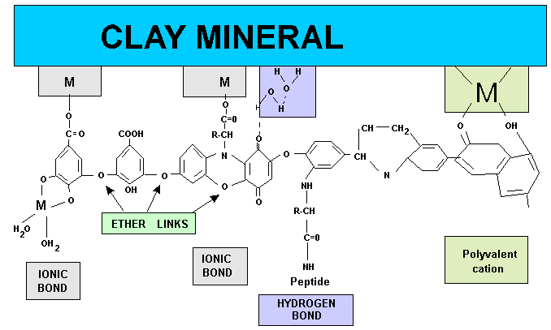
Adherence to clay
Notes:
These molecules are attached to the solid support through chemical bonds as ....

Slide 62
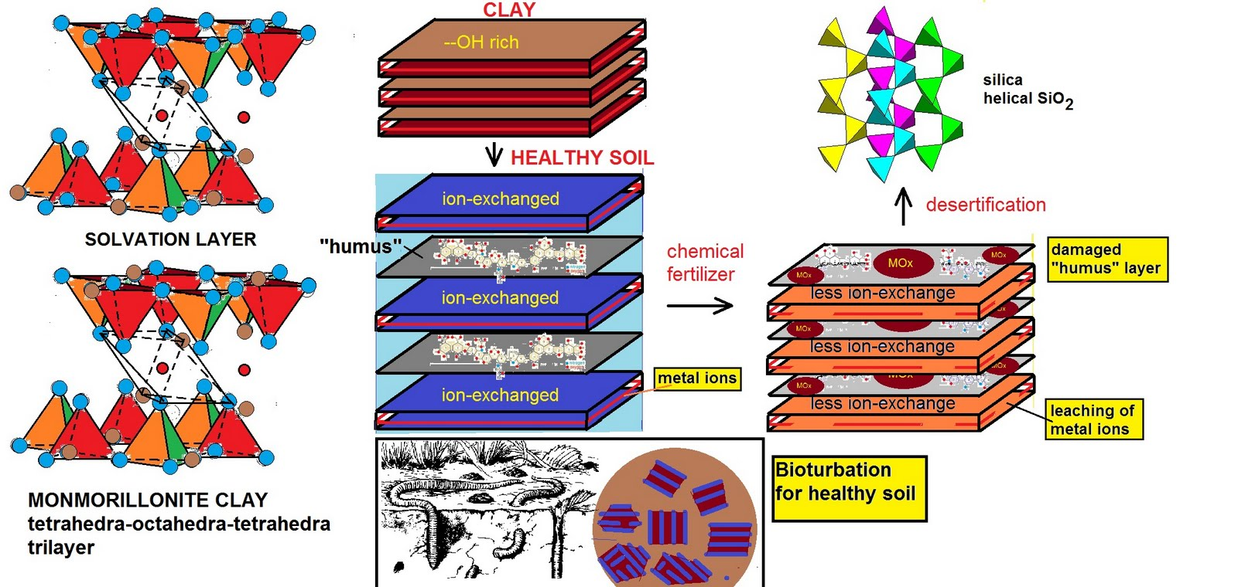
Location of formation of humus
Fernández-González MV, Martín-García JM, Delgado G, Párraga J, Delgado R. A study of the chemical, mineralogical and physicochemical properties of peloids prepared with two medicinal mineral waters from Lanjarón Spa (Granada, Spain). Applied Clay Science. 2013; 80–81: 107–116
Notes:
And formation takes place in solvation layers of clays, swelling them and altering the composition. As described professor Delgado (Granada University) in the solvation layer there is a micro-factory that alters the composition and characteristic of peloids. Alteration of this micro-factory by external substances or excessive over time, can affect its properties.

Slide 63
Peloids micro-factory
Fernández-González MV, Martín-García JM, Delgado G, Párraga J, Delgado R. A study of the chemical, mineralogical and physicochemical properties of peloids prepared with two medicinal mineral waters from Lanjarón Spa (Granada, Spain). Applied Clay Science. 2013; 80–81: 107–116
Serrano C. Romero M., Alou L, Sevillano D, Corvillo I, Armijo F, Maraver F. Survival of human pathogenic bacteria in different types of natural mineral water. J Water Health. 2012; 10(3): 400-5
Notes:
During peloid preparation and maturation, clays packets and crystals must be broken into smaller individual particles with more defects. Evidence for this hypothesis is that the kaolinite stacks were detected in the mineral (Fig. a) but not in the peloids, which were always composed of laminar particles.
 Whatever, our group found that the more concentrated the mineral water is, less possibility of growth of human pathogenic bacteria.

Slide 64
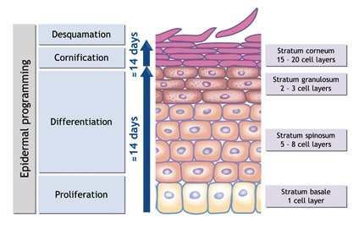
Skin Effect
Blood flow
Sebum
pH
Barrier function
Viscoelasticity
Dermal density
Notes:
As suggested, applying sulphur waters in the skin not only has an influence on epidermal turnover, eventually the dermis can also be altered, and they can affect many skin biophysical constants, as …
and them, with the aim of clarifying the different behaviour of sulphur peloids on the skin, we made the following experience with the following objectives:

Slide 65
Objectives
Establish the changes in the skin through biophysical techniques, after application of two sulphide peloids
To establish a relationship with their maturity
Try to know the ideal sulphurous mud, its behaviour on the skin
Notes:
To resolve these questions, we aimed to study two sulfurous peloids, with the follwing aobjectives:

Slide 66
Materials
2 type of peloids of two different sulphurous waters
3 stages of maturation: 0, 3 and 6 months
Peloids daily placed on volar forearm on 35 panelist at room temperature
Determinations on days 0, 10 and 20
Day zero values are considered normal skin pattern
Notes:
We conducted our research with the following materials:

Slide 67
Type of sulphurous waters
“Baños de Montemayor” Arqueta Spring
“Termas de Cuntis”
Calle Real Spring
Sulfide & Bicarbonated, Sodium
pH: 7.7
Spring: 42.2ºC
H₂S / HS⁻ ➔ 1.9 / 10.5 mg/L
Dry residue (110ºC):
  262.2 mg/L
Conductivity:
  395.1 μScm⁻¹
Sulfide & Carbohydrate, Chloride, Sodium
pH: 9.0
Spring: 52.5ºC
H₂S / HS⁻ ➔ 0 / 4.0 mg/L
Dry residue (110ºC):
  364.2 mg/L
Conductivity:
  522.0 μScm⁻¹
Notes:
To prepare peloids, we use two different types of sulphurous waters. The first from "Termas de Cuntis" more alkaline (purple in the picture) and the second from "Baños de Montemayor" less alkaline (orange in the picture). Logically, by pH, with different concentration to hydrogen sulphide.

Slide 68
Reduction force vs. pH
pH: 7.7
pH: 9.0
Notes:
We must remember that for its two different pH, have different composition and different reduction force.  One more powerful (violet) and the other with hydrogen sulphide (orange) theoretically weaker.

Slide 69
Peloids
Two peloids with a magnesium bentonite
Water
Magnesium Bentonite
1 : 2.4
Notes:
We produce a peloids with the minerals waters and a magnesium bentonite in a proportion 1:2.4.

Slide 70
Maturation
6 months
3 months
P₀ P₃ P₆
Notes:
Then, part of this peloid was matured at same established room temperature conditions, for 3 and 6 moths.

Slide 71
Methods
Visco-elasticity Cutometer MPA 850
Blood flow PeriFlux System 5000
pH Skin pHmeter 905
Dermal density Reviscometer RVM 600
TEWL Tewameter TM 210
Room temperature and humidity controlled
Notes:
We use different biophysical devices to determine the skin conditions, before treatment, and 10 and 20 days after beginning treatment.

Slide 72
P₀ Immature peloid (0 months)
Notes:
This graph represents the average of variation of different techniques with reference to baseline. Cuntis mineral water has no hydrogen sulphide and consequently practically does not increase the blood flow. Both peloids altering the skin barrier function (increasing TEWL). Virtually there are no skin pH variations and therefore we have no significant results. Dermic density increase, this is, the concentrations of fibroblasts an fibbers are higher. Decrease skin firmness and elasticity, that is, the skin is more plastic an less elastic. Finally conflicting results are obtained in the skin fatigue.

Slide 73
3 months peloid maturity (P₃)
Notes:
In many cases, three months maturation results are antagonistic, skin flux decreases, decreases TEWL etc. In this new graph we can see this better.

Slide 74
Basal variation (%) P₀ vs. P₃
Notes:
Between immature Peloid and three months mature, conflicting results are obtained in  blood flow, TEWL, dermal density, firmness and  elasticity.

Slide 75
6 months peloid maturity (P₆)

Slide 76
Basal variation (%) P₃ vs. P₆
Notes:
Antagonistic results are obtained also between the peloids with 3 and 6 months of maturation.

Slide 77
Basal variation (%)
P₀ vs. P₃ vs. P₆
Notes:
In a comparison of the results of the three peloids, it can be seen that the immature one and six months maturation obtained similar results, while the behaviour of three months maturation peloid, is very different.

Slide 78
Different types of sulphur?
Exogenous administration of H₂S elicits vascular relaxation in both in vitro and in vivo animal preparations
(Kutz et al., 2015, Zhao et al., 2001; Palese et al., 2008; Sun et al., 2011;
Tian et al., 2012; Chitnis et al., 2013)
HS⁻
H₂S
Transformations by maturation?
Concentration?
S²⁻
Jin Z, Chan H, Ning J, Lu K, Ma D. The role of hydrogen sulfide in pathologies of the vital organs and its clinical application. J Physiol Pharmacol. 2015; 66(2): 169-79.
Kutz JL et all. Evidence for a functional vasodilatory role for hydrogen sulfide in the human cutaneous microvasculature. J Physiol. 2015 Jan 30. doi: 10.1113/JP270054
Notes:
It’s well documented that hydrogen sulphide is responsible for capillary vasodilation. This leads us to think that the ....  But What about our conflicting results are due to a transformation of sulfur maturity? Are they due to a change in hydrogen sulfide concentration?  Are compatible these results as the hypothesis of the figure show? Its general opinionlike Jin et all. has very recently reported:  “While H2S generally has pro-survival and anti-apoptotic effects, at higher concentrations, this effect is reversed, and it becomes anti-proliferative and pro-apoptotic instead.”
Anyway ... .

Slide 79
Termas de Cuntis
Water
3 or 6 months of maturation
Magnesium Bentonite
P₃ is ideal for the treatment of scaly processes that need moderation skin cell turnover
P₆ is indicated on supported of inflammatory processes
Baños de Montemayor
Water
Hervideros de Cofrentes Water
≅
≅
Hypotonic sulphurous waters
Hypertonic
sodium chloride water
Notes:
P3 peloid, the peloid with three months of maturation, is ideal …..
Coincidentally,  we also obtained very similar results with a very hypertonic sodium chloride water from Cofrentes balneary, which already communicate in the ISMH Congress from year 2014 in Japan.

Slide 80
Conclusions
Time of maturation is very important and may have some antagonistic effects
The skin effects can be observed in 10 days
Maturation affects especially to some parameters
Notes:
Sulfurous water improve skin regeneration, not only by increasing keratinocyte proliferation and migration but also favourably modulating the regenerated collagen and elastic fibres in the dermis with an anti-inflammatory action and that the regenerative properties.
Faga A, Nicoletti G, Gregotti C, Finotti V, Nitto A, Gioglio L. Effects of thermal water on skin regeneration. Int J Mol Med. 2012; 29(5): 732-740

Slide 81
Last news!
Karl Schlossmann
Professor of Bacteriology of Tartu University
1939
Notes:
Surprisingly this book describes exactly the last progress with sulphurous water and peloids we have studied, whose foundations and properties, were minutely described by Karl Scholossmann, Professor of Bacteriology of Tartu University, in 1939.

Slide 82
Final conclusion
Just by reading this book, you could have saved the cost of my journey!
Tänan teid väga tähelepanu eest!
Notes:
So, as a final conclusion we can say:  Just by reading this book, you could have saved the cost of my journey! Although, I would have deprived the pleasure of being with you in the 190th anniversary of the Haapsalu health resort, participate in this meeting and see this beautiful country and its people.  Thank you for your attention.

